Slide 1
Computer Graphics: 2D – Clipping
Tommy Marrinan, PhD

Slide 2
What is Clipping?
Geometric primitives can have vertices outside the view rectangle
These vertices would map to incorrect (or non-existent) indices in the framebuffer
Clipping is the process of modifying or removing vertices such that an entire model exists within the view rectangle

Slide 3
Point Clipping
Accept and draw point if:
view_{xmin} ≤ x ≤ view_{xmax} and view_{ymin} ≤ y ≤ view_{ymax}
Otherwise reject (discard) point

Slide 4
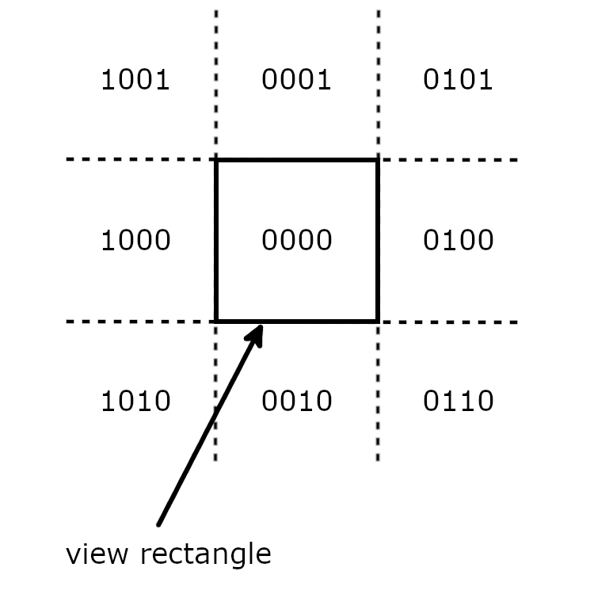
Line Clipping
Cohen-Sutherland algorithm
Divide view into 9 regions
Assign each an outcode
Outcode
1st bit: left of left edge
2nd bit: right of right edge
3rd bit: below the bottom edge
4th bit: above the top edge

Slide 5
Line Clipping
Trivial Accept
Both endpoints are within the view rectangle
Bitwise OR the outcodes – result equals 0
Trivial Reject
Both endpoints lie outside the same edge
Bitwise AND the outcode – result not 0
Otherwise, investigate further

Slide 6
Line Clipping
Select an endpoint that lies outside the view rectangle
1 (if not both) guaranteed to be outside
Find 1st bit set to 1 in selected endpoint’s outcode
Calculate intersection point between line and corresponding edge
Replace selected endpoint with this intersection point
Recalculate endpoint’s outcode
Repeat until trivially accepted or rejected

Slide 7
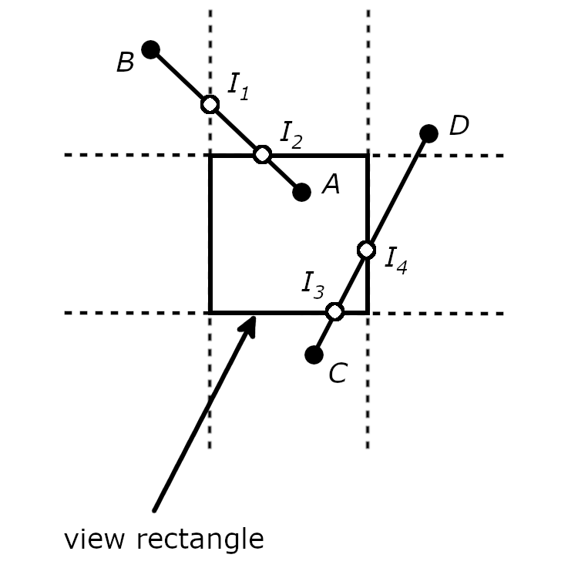
Line Clipping
Example
AB first clipped against left edge, then against top edge
CD first clipped against bottom edge, then against right edge

Slide 8
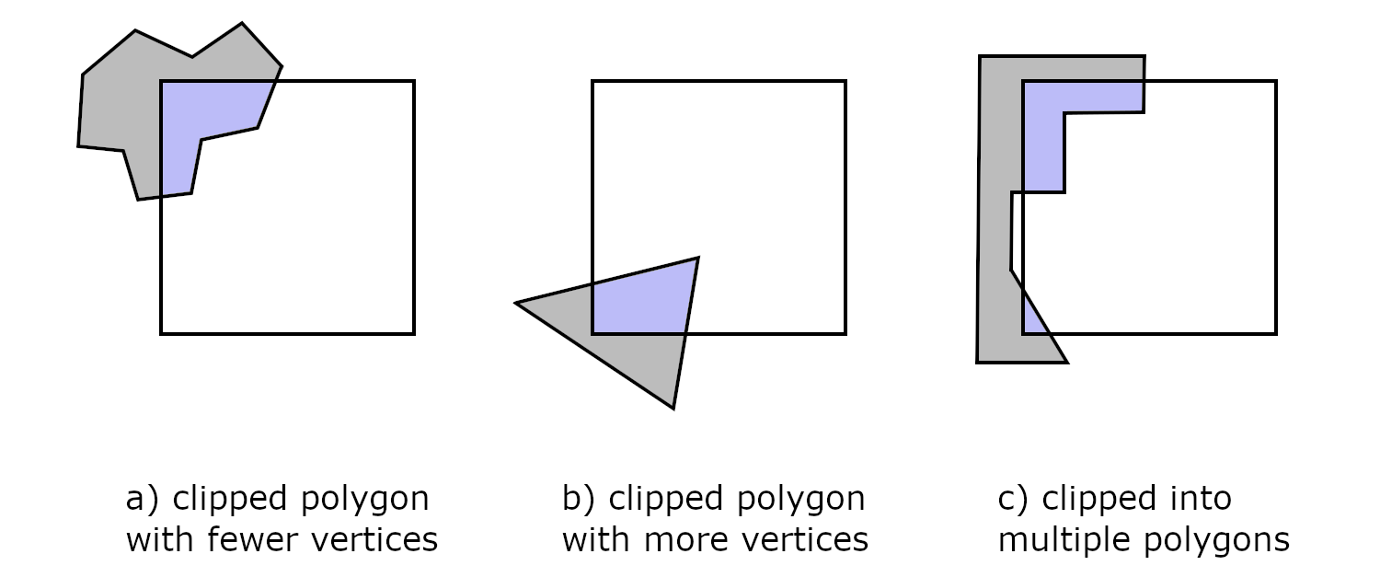
Polygon Clipping
Sutherland-Hodgman algorithm
Iteratively clip against one edge at a time
Clipped polygons can look quite different from original
Fewer vertices, more vertices, multiple polygons

Slide 9
Polygon Clipping
Clip against 1 edge at a time
Output of 1 edge becomes input of next edge
4 possible cases for each edge (endpoints p₀ and p₁)
Both p0 and p1 are inside clip edge
Both p0 and p1 are outside clip edge
p0 is inside clip edge, but p1 is outside clip edge
p0 is outside clip edge, but p1 is inside clip edge

Slide 10
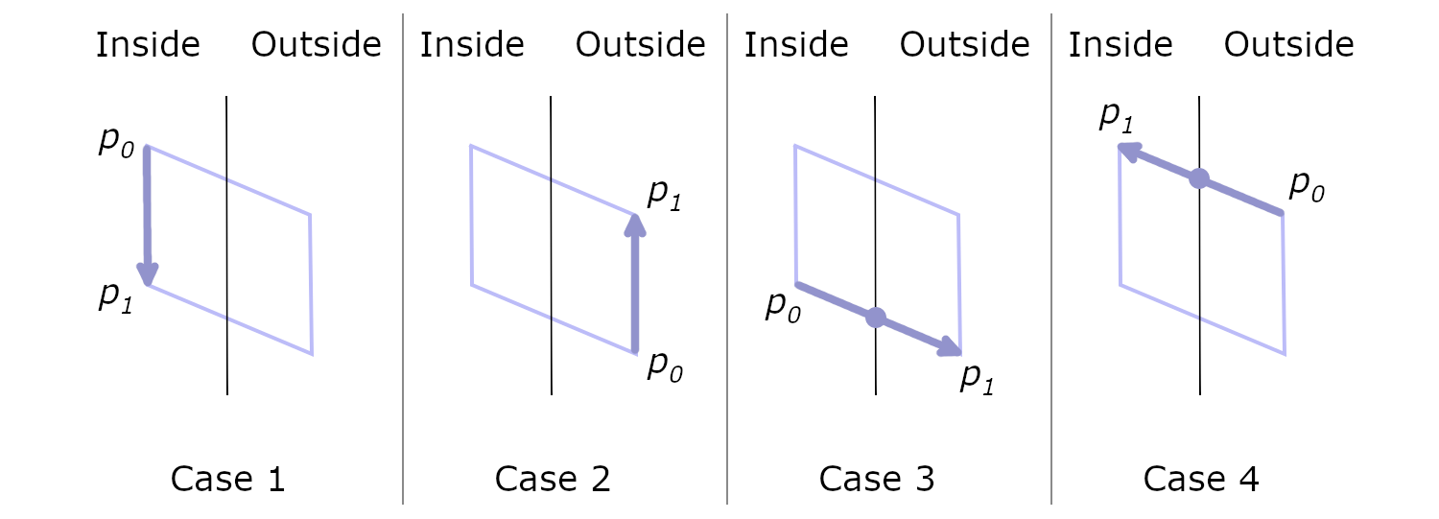
Polygon Clipping
New sequence of vertices created after clipping
Recall that the resulting polygon can have fewer or more vertices than the original

Slide 11
Polygon Clipping
Case 1
Add p₁ to the output sequence
Case 2
Don’t add anything
Case 3
Add intersection point
Case 4
Add intersection point and p₁

